Slide 1
Basin Range Transition
Presented by Dan Dziekan and Richard Fletcher

Slide 2
1
Day Field Guide Overview
2
Stop One: Lava Butte
Stop Two: Paulina Peak
Stop Three: Hole in the Ground
Stop Four: Green Mountain Lookout
Stop Five: Crack in the Ground
Stop Six: Winter Ridge
Stop Seven: Ana River Fault at Summer Lake
3
4
5
6
7

Slide 3
Brief Newberry Overview
Named after John Newberry
Caldera reaches 2,400 meters
Formed 80,000 years ago
Most recent eruption 1,300 years ago
Formed from Rhyolite to Basalt flows

Slide 4
Lava Butte
Northern most vent along Holocene fissure
Extends 30 km south to Newberry
Erupted 7,000 years ago
Began as a 2.4 km long fissure
Concentrated at the site of Lava Butte
150 m high cinder cone
Eruptive products cover 23 km squared
Flows erupted from various vents

Slide 5
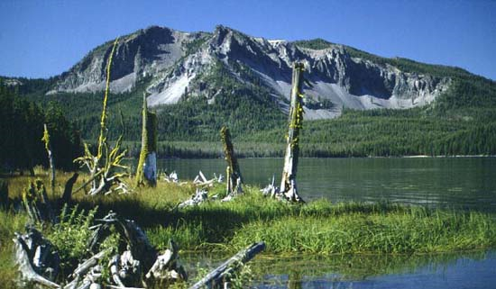
Paulina Peak
Located on southern side of Newberry Caldera
Provides Great view of many flows

Slide 6
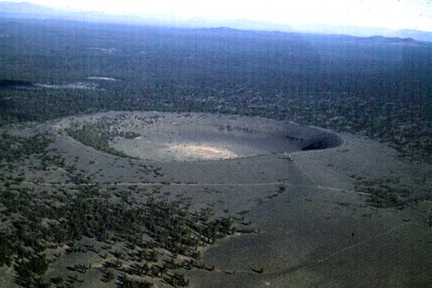
Hole in the Ground
Maar formed when Newberry Lavas entered water saturated sediment of Fort Rock basin 50-100 thousand years ago.
Premature eruption

Slide 7
Green Mountain Lookout
Basalt Shield
Fed lava flow at Crack in the Ground
Around 740 thousand years ago
East lava field erupted from Lava Mountain Shield Volcano
Marked by a 1.6km long series of craters

Slide 8
Crack in the Ground
Northwest striking crack
Coincides with a Quaternary normal fault trace
Crack penetrates more than one lava flow
Suggests tectonic rather than volcanic
About 10 meters of vertical displacement

Slide 10
Winter Ridge
Stop located in the foot wall of Winter Ridge fault system
Viewpoint allows for multiple fault to be observed
Defines first extensional escarpment

Slide 11
Summer Lake
Pleistocene pluvial lake called Lake Chewaucan
Occupied basin formed between Winter Ridge and Abert Rim
Ana River and Winter Ridge faults cut shorelines

