Slide 1
Powerpoint Level 1
CS 121 Western Oregon University

Slide 2
Topics covered in this tutorial:
Creating a slideshow
Utilizing slideshow templates
Utilizing tables
Inserting pictures

Slide 3
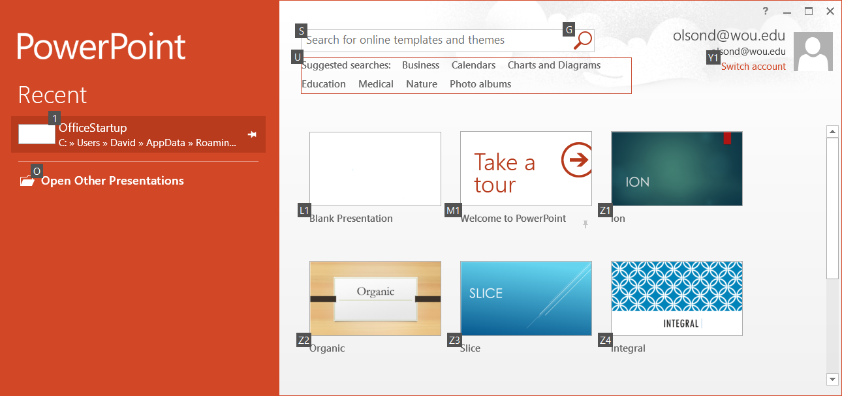
1.0 Choose blank presentation. You might also take the tour.

Slide 4
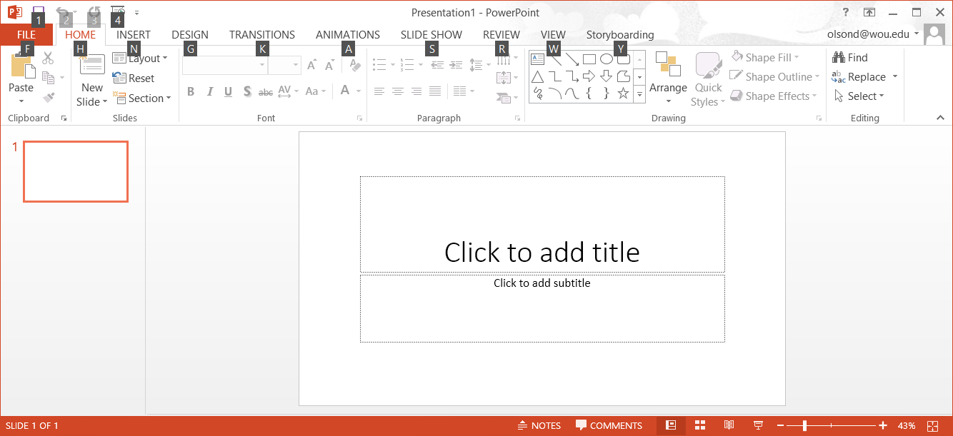
1.1 As with Excel, the Ribbon contains all the commands necessary to perform common tasks. Each of the tabs exposes multiple commands.

Slide 5
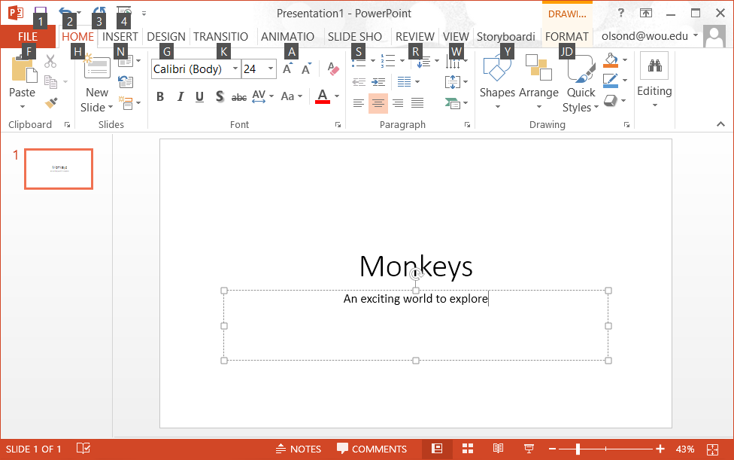
1.3 Chose a title and subtitle for your presentation. Yours should be different than the example (Slide 1)

Slide 6
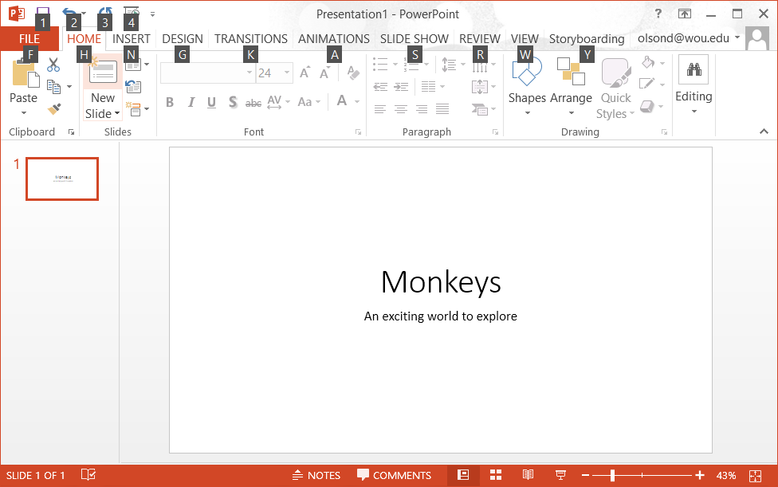
1.3 Click on the new slide option. You can also use the key option of Ctrl-M

Slide 7
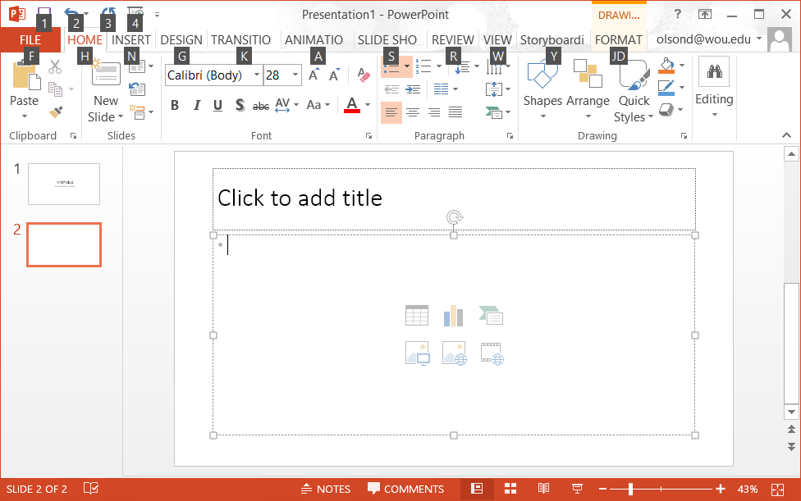
1.4 Not only does a new slide appear in the screen, but it location relative to other slices shows up in the slide navigation pane.

Slide 8
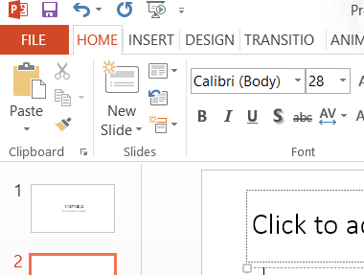
1.5 Once you have created the new slide. Click on the slide layout tool. It allows you to choose one of the pre-designed slide layouts.

Slide 9
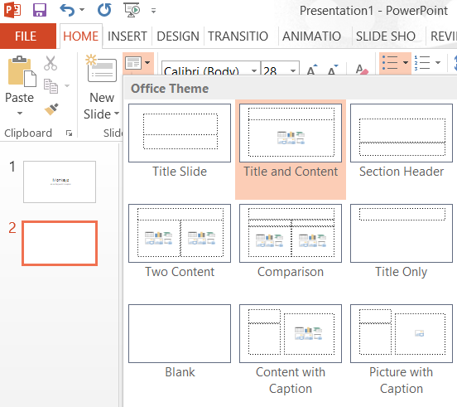
1.6 The resulting menu gives several slide formats to choose from. Choose Title and Content.

Slide 10
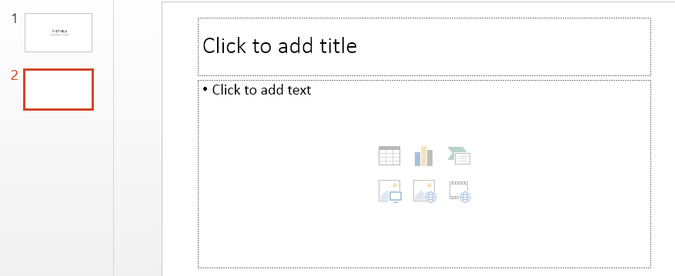
2.1 Click on the upper left icon, insert table. Create a table with 4 rows and four columns.

Slide 11
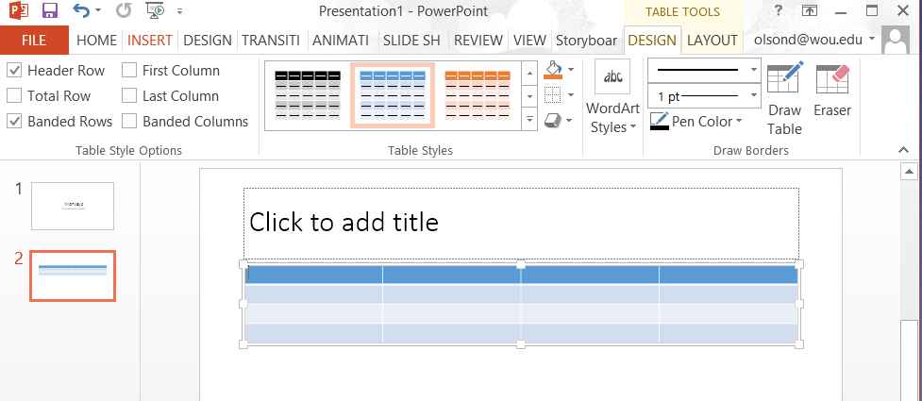
2.3 Add a title and type relevant information into the table.

Slide 12
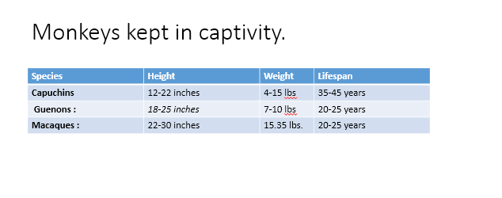
Fill in the table with some information from the internet, the goes with the title slide you selected. (Slide 2)

Slide 13
3.0 Create a third slide. Once again choose a slide and content slide. Choose another one of the built-in types. The example presentation choose “Insert Picture”. You will need to download a picture from the internet for this part.
3.1 Add a title to your picture. Center the title (Slide 3)

Slide 14
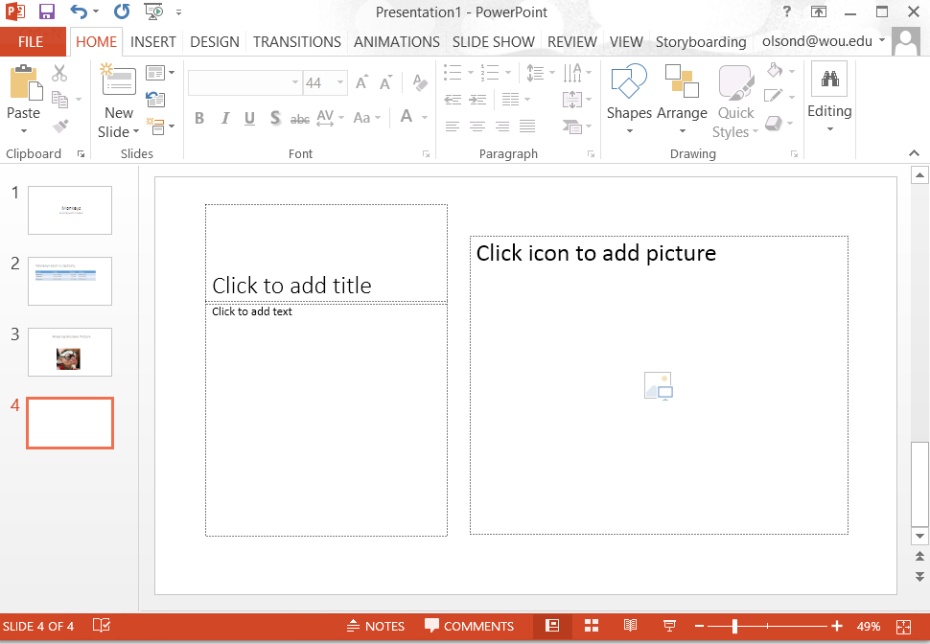
4.0 Add one more slide to your presentation. Choose any of the office themes. In the example, we chose picture with caption.

Slide 15
Slide 4 Completed. Once you have these four slides you are done with the assignment and ready to move on to the lab.

