Slide 1







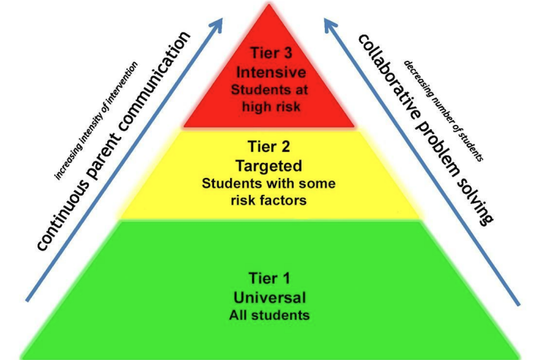


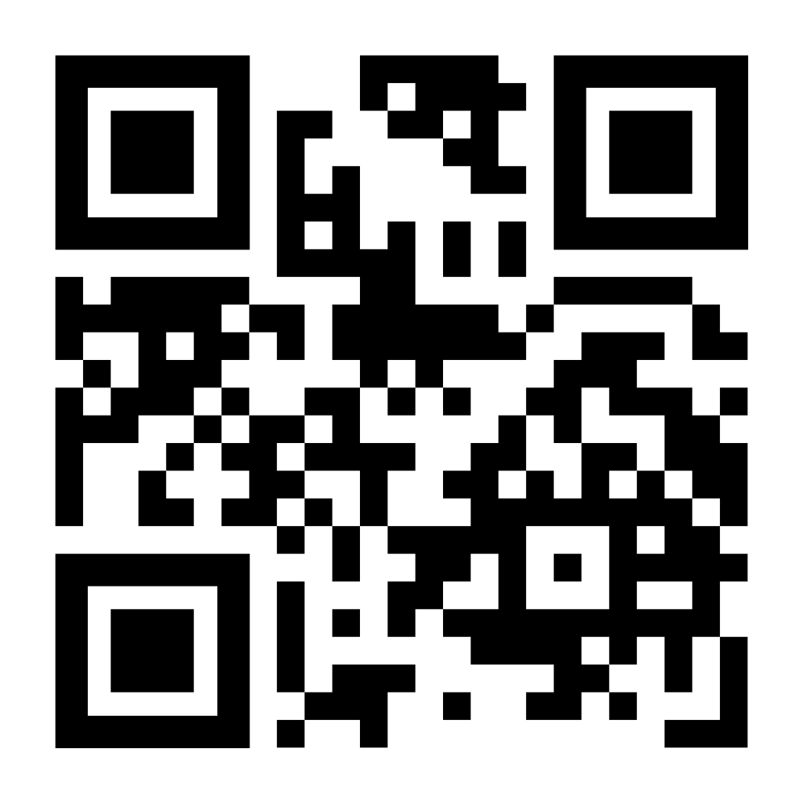
Evaluating Sheridan School District Comprehensive Substance Use Prevention Plan: Guiding the Development of Evidenced-Based Interventions for Students at Moderate Risk
Jenny Parker & Karina Villa Diaz
Aim/Objectives
Discussion
Results/Findings
Evaluation of current substance use prevention plan to optimize district resources.
Implement an anonymous reporting system at high school.
Provide additional recommendations for resource utilization.
Adolescents in rural communities are at increased risk for substance use and suicide (Rural Health Information Hub, 2024).
Anonymous reporting systems can promote cohesiveness and improve student outcomes (Hsieh et al., 2022).
One key protective factor for substance use in youth is a cohesive school environment. (Center for Disease Control and Prevention, 2022).
The current substance use prevention plan has not been updated in approximately two years.
Opportunity for additional support for Sheridan to incorporate evidence-based practices.
Stakeholders demonstrated a desire to address substance use prevention district-wide.
Limitations
Background
Limited resources.
Lack of trust within the community.
Time constraints.
Oregon ranks third nationally in the rate for substance use disorder in youth (Green, 2024).
60% of Oregon school districts DO NOT use substance use prevention programs that meet even the lowest bar for evidence (Mental Health America, 2024).
Oregon Admin Code 581-022-2045 requires school districts to have a comprehensive substance use prevention plan. (Substance Use Prevention and Intervention Plan, 2024).
Looking Forward
Monitor the anonymous reporting system for trends.
School board and substance use prevention task force to consider recommendations and evidence-based interventions.
Substance use prevention plan to be reviewed and updated annually.
Methodology/PIP Model
The logic model was utilized and guided the assessment, evaluation, and recommendations for the PIP.
Literature review using PubMed, CINAHL, and legal references.
(American Academy, 2017)
Scan For Anonymous Reporting Form
References Available Upon Request

