Slide 1
UNIVERSITY FINANCIAL UPDATE
February 6, 2020
Prepared by: Dr. Ana Karaman, VPFA & CFO; Camarie Moreno, Director of Budget & Planning; and Gabe Dougherty, Controller
Notes:
Same presentation as FAC, UC, BOT, highlights TFAC

Slide 2
TYPES OF FUNDS
Education & General (E&G) – operational – tuition & fee revenue, state appropriation, instructional expenses, administrative expenses, institutional support, etc.
Auxiliaries – bookstore, housing, dining, athletics, Incidental Fee Committee (IFC), etc.
Capital – buildings, repairs, etc.
Primary source of funding is through bonds from the state which are restricted for use on capital (not fungible)
Grants – financial aid, federal & state grants, research, etc.
Other Funds – DesOps, Service, Restricted
Notes:
Enrollment impacts all major sources of revenue: tuition and fees, auxiliary enterprises, and adversely impacts SSCM (SCH and degrees granted)

Slide 3
HISTORICAL CHANGES

Slide 4
HISTORICAL E&G REVENUES (ACTUALS)
While the gap is narrowing between state appropriations and tuition, this is a reflection of a decline in enrollment
* 2019-20 based on budgeted revenues

Slide 5
STATE ALLOCATION: Students Success and Completion Model – FY20 $26.842M
Mission Differentiation Allocation is completed first, with the remaining funds then being allocated 60% to Outcomes-Based and 40% to Activity-Based
Consists of three components:
Mission Differentiation Funding Allocation ($7.6M) – supports a public university’s activities consistent with Regional Support, Mission Support, and Research Support
Outcomes-Based Allocation ($11.4M) – determined by the most recent three-year average total cost weighted degrees produced, student type, and priority area
Activity-Based Allocation ($7.8M) – determined by the most recent three-year average total, cost weighted, completed, resident student credit hours (SCH)

Slide 6
HISTORICAL ENROLLMENT

Slide 7
HISTORICAL E&G EXPENSES (ACTUALS)
* 2019-20 based on budgeted expenses

Slide 8
FY20 Budget

Slide 9
FY20 BUDGET CREATION PROCESS
Engage all relevant campus stakeholders
26 meetings, including LAS, COE, divisions of Academic Affairs, Student Affairs, General Counsel, Development & Advancement, Finance & Administration, and Auxiliary Services
Tuition & Fee Advisory Committee (TFAC) – lowest resident undergrad tuition increase of 2.33% ($4/credit)
University Budget Advisory Committee (UBAC) – 9 funded proposals, totaling $987K
Incidental Fee Committee (IFC) – set incidental fee and allocation ($16 increase, 4.4%)
Notes:
UBAC
Salem Presence ($401K)
Organizational Leadership program ($150K)
Open Educational Resource incentives/textbook rental initiative ($15K recurring & $20K one-time)
New Paralegal position for General Counsel ($88K)
Strong Start Scholars program to support students interested in STEM fields ($19K)
Funding to continue CASA services that were previously funded by a grant ($103K)
Funding to improve experiential learning ($12K)
New Institutional Research Analyst $102K
Funding for a temporary position to improve web marketing ($77K)

Slide 10
FY20 ADOPTED BUDGET ASSUMPTIONS & ENHANCEMENTS
Tuition revenues were built on assumed flat enrollment & $6.3M of fee remissions
FY18 – 3% down
FY19 – 1% up
State Allocation was unknown ranging from $40.5M to $120M being added to the PUSF fund
Ultimately, $100M was added to the PUSF; $120M (which would have maintained CSL for universities) would have resulted in an additional $550K to WOU
Other revenues were assumed flat
Flat S&S expense, minimum wage increase for students, $500K for classified raises, $500K for faculty raises, $350K for unclassified raises, $1.3M retirement increase
Resulted in $1.3M E&G budget deficit
Notes:
Flat enrollment: applications and admissions were tracking ahead of the previous year until June
FY18 – 3% down
FY19 – 1% up

Slide 11
FY20 ADJUSTED BUDGET
Tuition revenues built on fall census – an ~5% decline from prior year & $5.4M of fee remissions
Reallocated $521K of fee remissions to lottery & $400K due to fewer students
To maintain the original $1.3M deficit, $3.3M of budget cuts were needed
To date, we have identified & reduced the budget by $1.9M
Fee remissions are projected to be $6.5M ($1.2M over the revised budget)
We need to find $3M additional budget savings

Slide 12
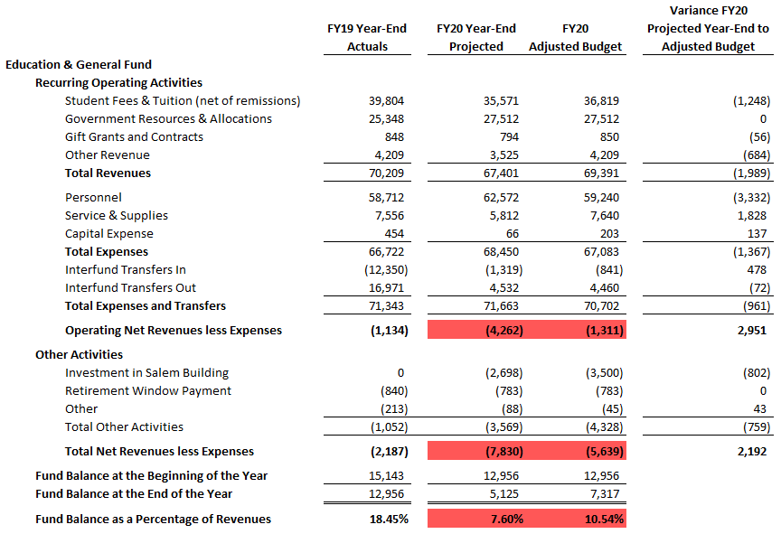
FY20 YEAR-END FORECAST

Slide 13
FY21 Budget
Planning

Slide 14
FY21 BUDGET
Planning stages
TFAC process underway – goal of resident undergrad tuition increase of less than 5%
UBAC process underway – 37 proposals received & being reviewed in phase 1
IFC process underway – potential restructuring of fee, increase of less than 5%
Assuming enrollment decline of 2.5%

Slide 15
NEXT FINANCIAL REPORT
Current Fiscal Year
Management report through February 2020
Year-end forecast based on period 8 actuals
Update on current capital projects
Next Fiscal Year
Tuition recommendation from TFAC
IFC decision on incidental fee
Management recommendation on other tuition and fees
Update on future capital projects

