Slide 1

Morphology and Spatial Distribution of Cinder Cones at Newberry Volcano, Oregon: Implications for Relative Ages and Structural Control on Eruptive Process
Steve Taylor
Earth and Physical Sciences Department
Western Oregon University
Monmouth, Oregon 97361

Slide 2
Introduction
Geologic Setting
Morphometric Analysis
Cone Alignment Analysis
Summary and Conclusion

Slide 3
INTRODUCTION

Slide 4
History of Newberry Work at Western Oregon University
2000 Friends of the Pleistocene Field Trip to Newberry Volcano
2002-2003 Giles and others, GIS Compilation and Digitization of
Newberry Geologic Map (after MacLeod and others, 1995)
2003 Taylor and others, Cinder Cone Volume and Morphometric Analysis I (GSA Fall Meeting)
2005 Taylor and others, Spatial Analysis of Cinder Cone Distribution II (GSA Fall Meeting)
2007 Taylor and others, Synthesis of Cinder Cone Morphometric and Spatial Analyses (GSA Cordilleran Section Meeting)
2001-Present Templeton, Petrology and Volcanology of Pleistocene
Ash-Flow Tuffs (GSA Cordilleran Meeting 2004; Oregon Academy of Science, 2007; GSA Annual Meeting 2009; AGU Annual Meeting 2010)
2011-Present Taylor and WOU Students, ES407 Senior Seminar Project,
Pilot Testing of Lidar Methodologies on Cinder Cone Morphometry
NOTE: Work presented today was conducted in pre-Lidar days mid-2000’s

Slide 5
Geologic Setting

Slide 7
Geology after Walker and MacLeod (1991); Isochrons in 1 m.y. increments (after MacLeod and others, 1976)

Slide 8
Basaltic Flows (Pl.- H)
Tepee Draw Tuff
Caldera
Cinder Cones “Qc”

Slide 9
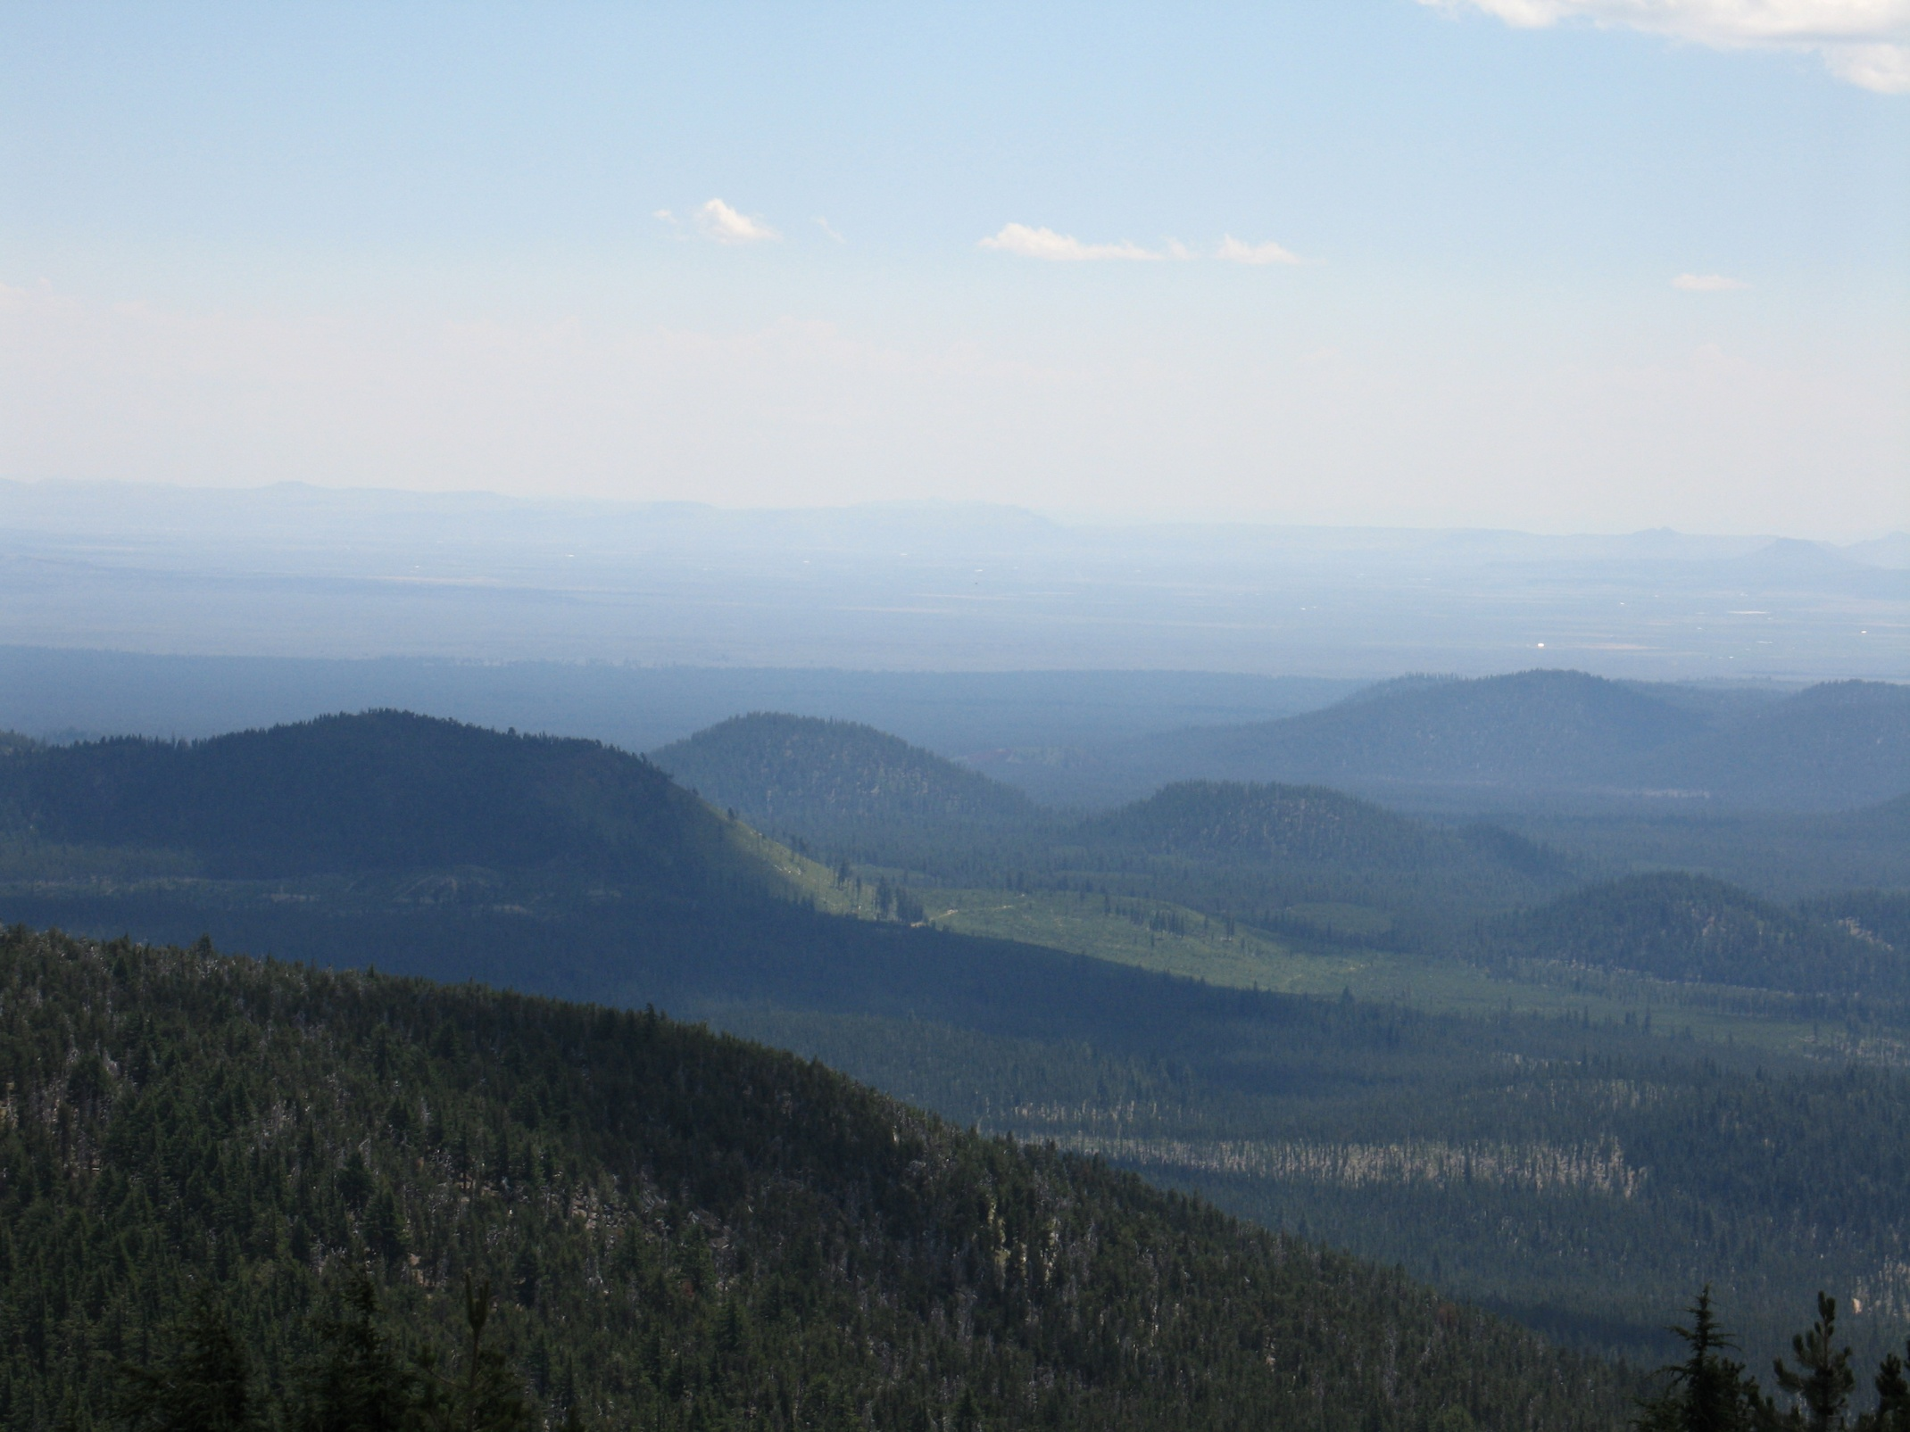
Southeast Cinder Cone Field

Slide 10
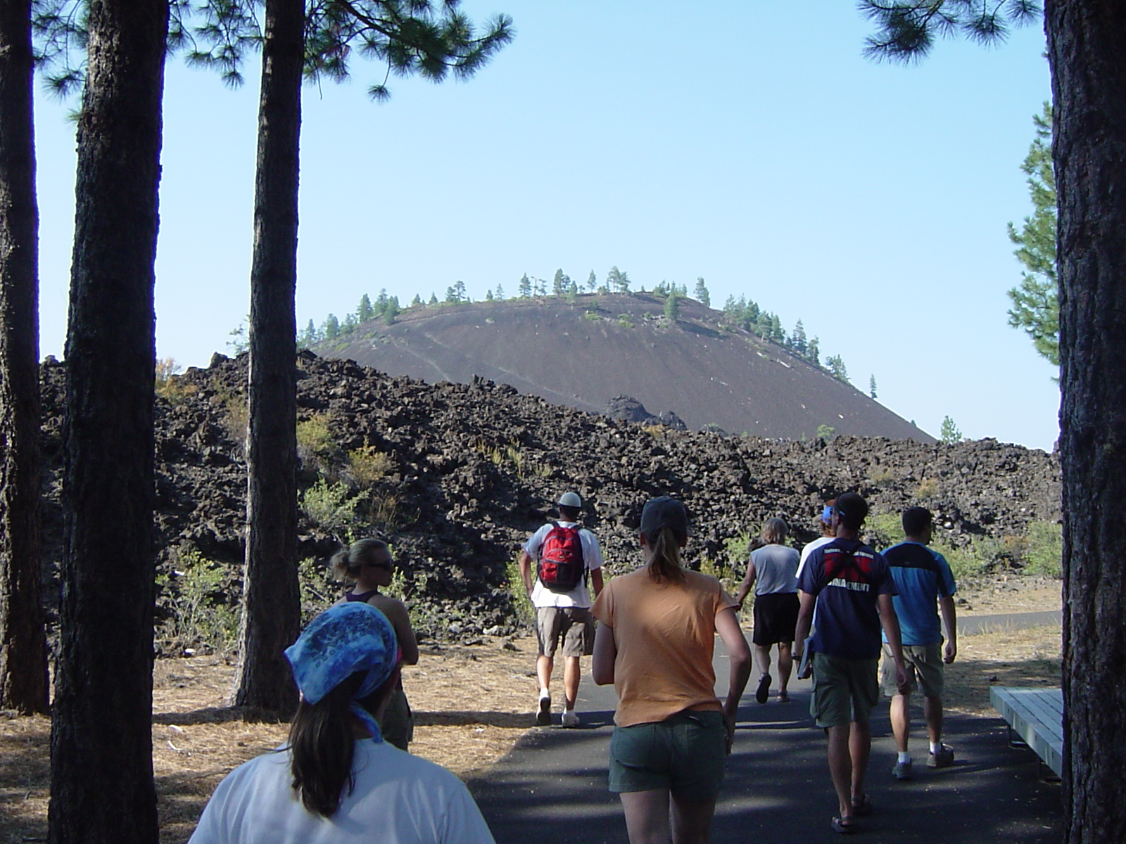
Lava Butte: Poster child of cone youth…

Slide 11
GEOMORPHIC ANALYSIS OF
CINDER CONES

Slide 12
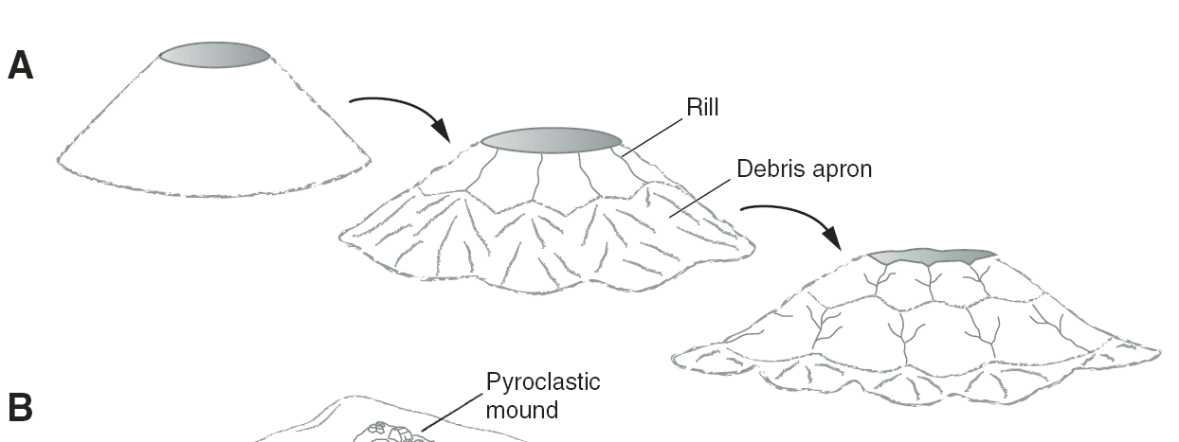
Cinder Cone Morphology and Degradation Over Time
Wcr
Wcr = crater diameter
Wco = cone basal diameter
Hco = cone height
S = average cone slope
Hco
S
Wco
(Dohrenwend et al., 1986)
MASS WASTING AND SLOPE WASH PROCESSES:
Transfer primary cone mass to debris apron
Cone Relief Decreases
Cone Slope Decreases
Hco/Wco Ratio Decreases
Loss of Cater Definition
Increased Drainage Density
Time
(Valentine et al., 2006)

Slide 13
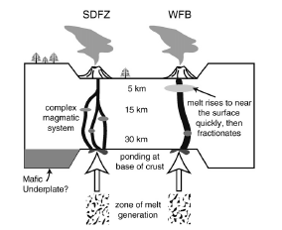
Cone Alignment Via Fracture-Related Plumbing
Newberry: Junction of Tumalo-Brothers-Walker Rim Fault Zones
Rooney et al., 2011

Slide 14
Cinder Cone Research Questions
Are there morphologic groupings of ~400 cinder cones at Newberry? Can they be quantitatively documented?
Are morphologic groupings associated with age and state of erosional degradation?
Are there spatial patterns associated with the frequency, occurrence, and volume of cinder cones?
Are there spatial alignment patterns? Can they be statistically documented?
Do regional stress fields and fracture mechanics control the emplacement of cinder cones at Newberry volcano?

Slide 15
Methodology
Digital Geologic Map Compilation / GIS of Newberry Volcano (after McLeod and others, 1995)
GIS analysis of USGS 10-m DEMs
  Phase 1 Single Cones/Vents (n = 182)
  Phase 2 Composite Cones/Vents (n = 165)
Morphometric analyses
  Cone Relief, Slope, Height/Width Ratio
  Morphometric Classification
Volumetric Analyses
  Cone Volume Modeling
  Volume Distribution Analysis
Cone Alignment Analysis
  Two-point Line Azimuth Distribution
  Comparative Monte Carlo Modeling (Random vs. Actual)

Slide 16
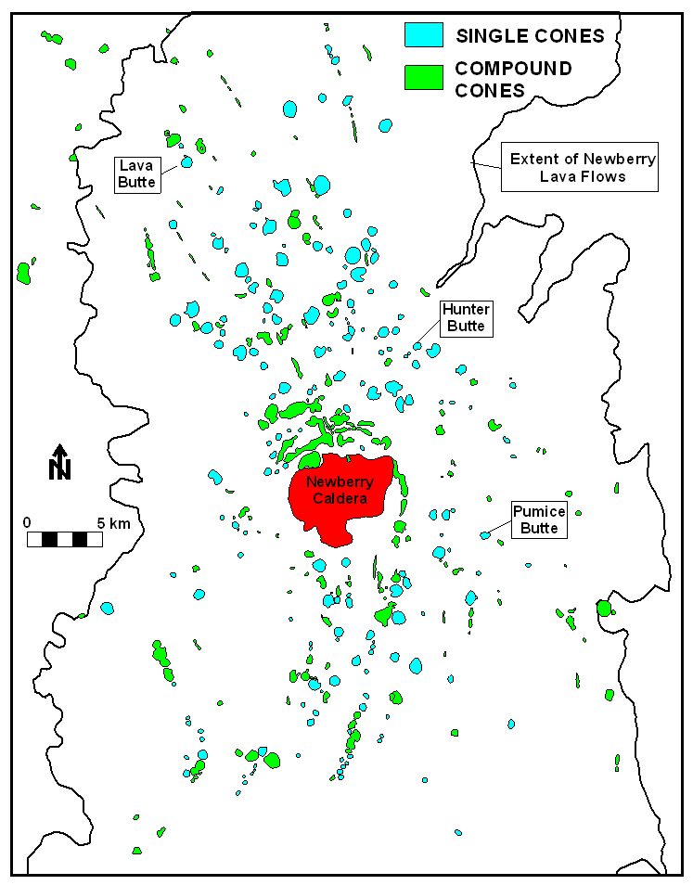
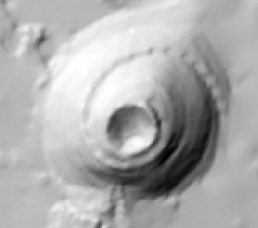
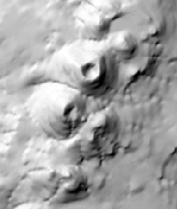
Single Cone DEM Example
COMPOSITE
(n = 182)
(n = 165)
Composite Cone
DEM Example

Slide 17
RESULTS OF MORPHOMETRIC ANALYSES – SINGLE CONES

Slide 18
Single Cones (n=182)

Slide 19
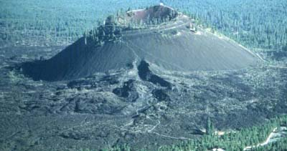

Slide 20
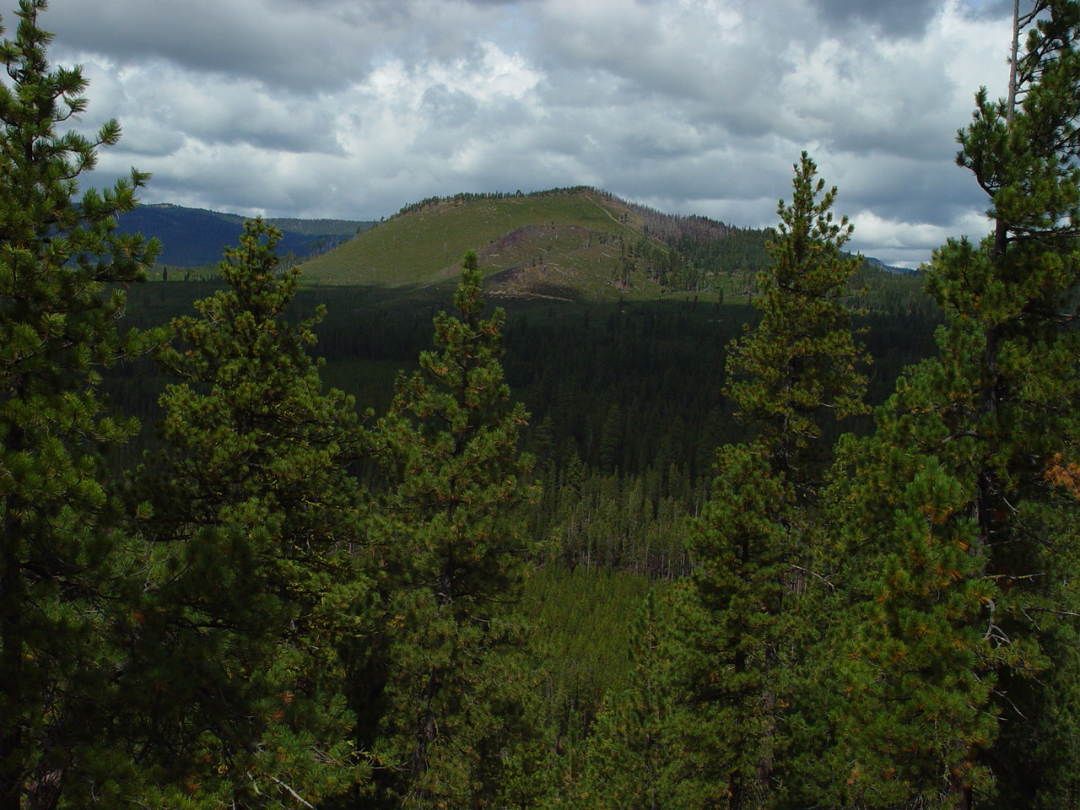

Slide 21
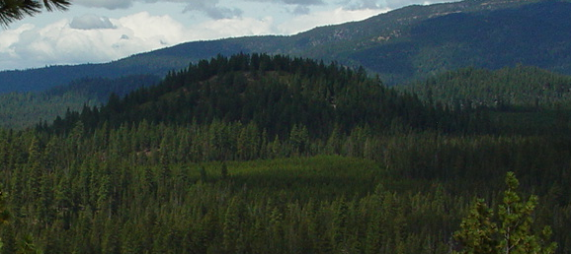

Slide 22
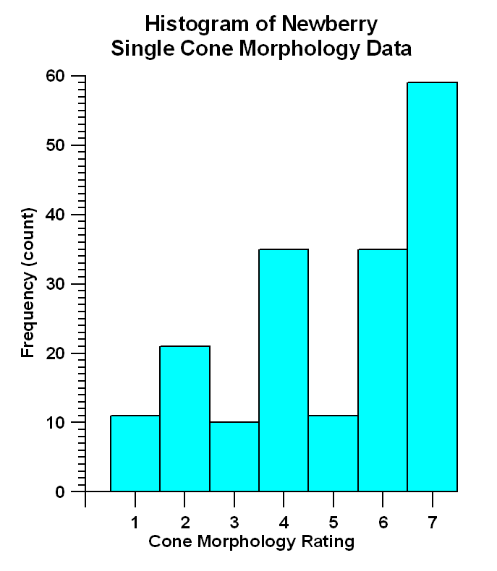
n=182

Slide 23
Single Cones

Slide 24
Single Cones
Reject H_{o}
Reject H_{o}
Reject H_{o}

Slide 25
Single Cones

Slide 26
Single Cones

Slide 27
Single Cones

Slide 28
“Youthful”
“Mature”
Northern Domain
Group I: n = 26 (14%) Group II: n = 76 (42%)
Southern Domain
Group I: n = 16 (9%)
Group II: n = 64 (35%)
Single Cones

Slide 29
VOLUMETRIC ANALYSES:
SINGLE + COMPOSITE CONES

Slide 30
VOLUME METHODOLOGY
Clip cone footprint from 10-m USGS DEM (Rectangle 2x Cone Dimension)
Zero-mask cone elevations, based on mapped extent from MacLeod and others (1995)
Re-interpolate “beheaded” cone elevations using kriging algorithm
Cone Volume =
(Cone Surface – Mask Surface)
Original DEM of
Lava Butte
Masked DEM of
Lava Butte

Slide 31
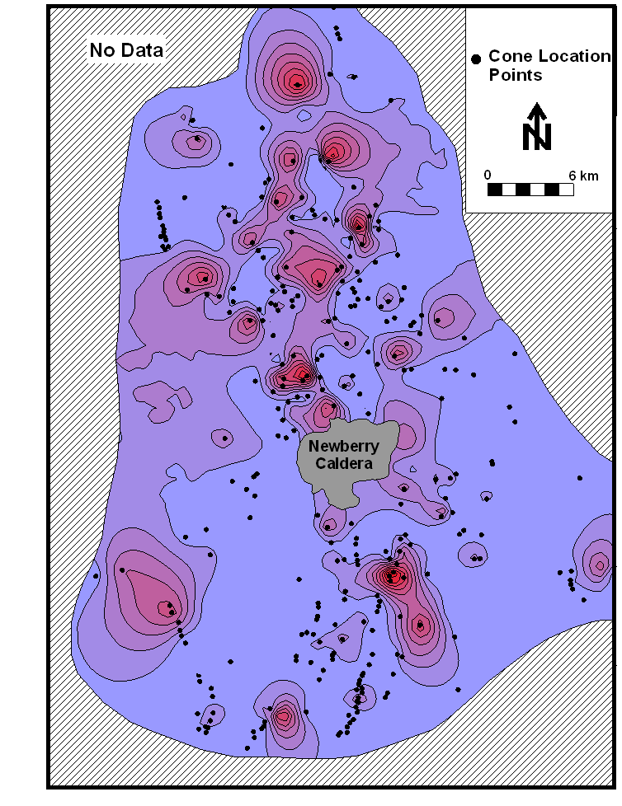
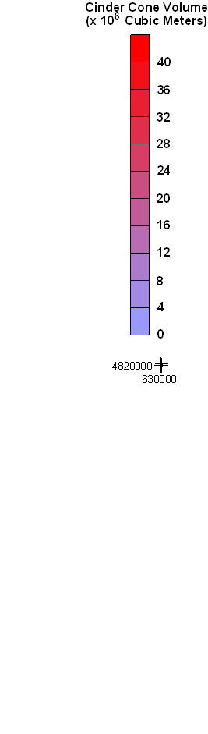
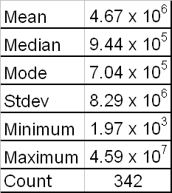
CONE VOLUME SUMMARY
(SINGLE AND COMPOSITE)
Cubic Meters

Slide 32
CONE ALIGNMENT ANALYSES
SINGLE + COMPOSITE

Slide 33
REGIONAL FAULT-
TREND ANALYSIS

Slide 34
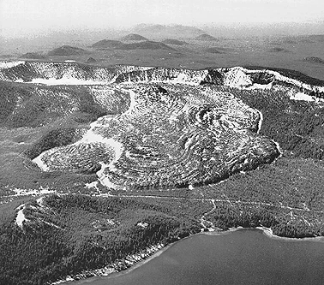
Cone lineaments anyone? Question: How many lines can be created by connecting the dots between 296 select cone center points?

Slide 35
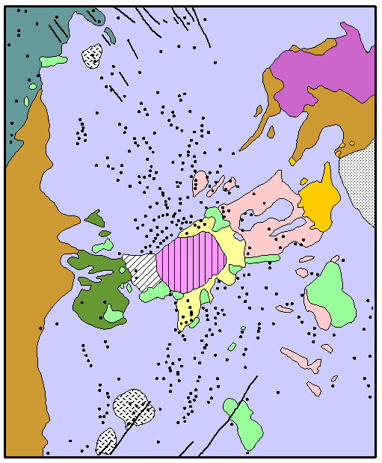
Answer:
Total Lines = [n(n-1)]/2 =
[296*295]/2 = 43,660
possible line combinations
Follow-up Question: Which cone lineaments are due to random chance and which are statistically and geologically significant?

Slide 36
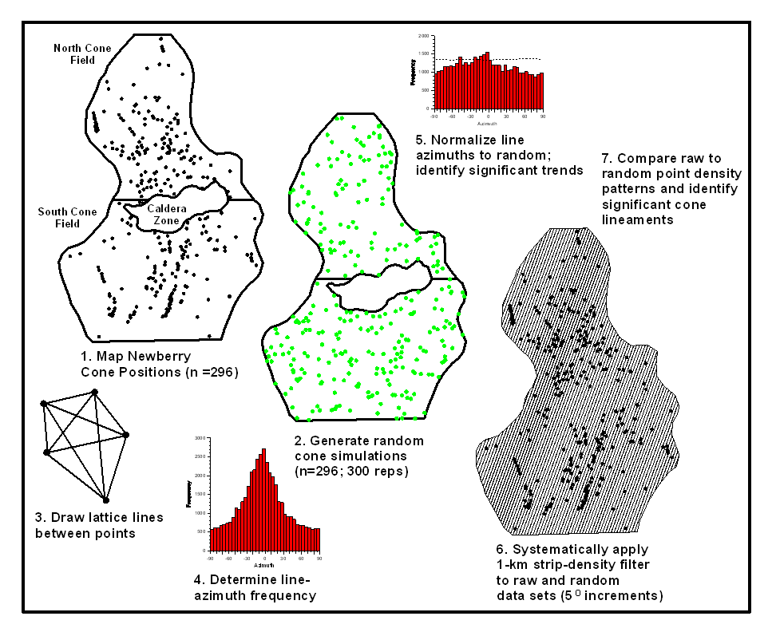
METHODS OF CONE LINEAMENT ANALYSIS
Frequency
GIS
Azimuth
“POINT-DENSITY
METHOD”
(Zhang and
Lutz, 1989)
Frequency
“TWO-POINT
METHOD”
(Lutz, 1986)
Azimuth

Slide 37
CONE TWO-POINT ALIGNMENT ANALYSIS (after Lutz, 1986)
Normalized Two-Point Cone Azimuths
NULL HYPOTHESIS
Distribution of Actual Cone Alignments = Random Cone Alignments
95% Critical Value
EXPECTED ALIGNMENT FREQUENCY:
F_{EXP} = (n*(n-1) / (2*k))
n = No. of Cinder Cones
k = No. of Azimuthal Bins
Random Two-Point Cone Azimuths
n = 296 / replicate
Replicates = 300
NORMALIZED ALIGNMENT FREQUENCY:
F_{NORM} = (F_{EXP} / F_{AVG}) * F_{OBS}
F_{NORM} = normalized bin frequency
F_{EXP} = expected bin frequency
F_{AVG} = average random bin frequency
F_{OBS} = observed bin frequency
Actual Two-Point Cone Azimuths
CRITICAL VALUE:
L_{I} = [(F_{EXP} / F_{AVG}) * F_{AVG}] + (t_{CRIT} * R_{STD})
F_{EXP} = expected bin frequency
F_{AVG} = average random bin frequency
R_{STD} = stdev of random bin frequency
t_{CRIT} = t distribution (α = 0.05)
n = 296
Line Segments = 43,660

Slide 38
TWO-POINT ANALYSIS RESULTS
NORTH DOMAIN
SOUTH DOMAIN
95% Critical Value
95% Critical Value
n = 149 / replicate
Replicates = 300
n = 147 / replicate
Replicates = 300
n = 149 cones
Line Segments = 11,026
n = 147 cones
Line Segments = 10,731

Slide 39
POINT-DENSITY METHOD
(Zhang and Lutz, 1989)
1-km wide filter strips with 50% overlap
Filter strip-sets rotated at 5-degree azimuth increments
Tally total number of cones / strip / azimuth bin
Calculate cone density per unit area
Compare actual densities to random (replicates = 50)
Normalize Cone Densities: D = (d – M) / S
D = normalized cone density
d = actual cone density (no. / sq. km)
M = average density of random points (n = 50 reps)
S = random standard deviation
Significant cone lineaments = >2-3 STDEV above random

Slide 41
SUMMARY AND CONCLUSION

Slide 42
I. CONE MORPHOLOGY
Degradation Models Through Time (Dohrenwend and others, 1986)
Diffusive mass wasting processes
Mass transfer: primary cone slope to debris apron
Reduction of cone height and slope
Loss of crater definition
Newberry Results (Taylor and others, 2003)
Group I Cones: Avg. Slope = 19-20º; Avg. Relief = 125 m; Avg. H_{c}/W_{c} = 0.19
Group II Cones: Avg. Slope = 11-15º; Avg. Relief = 65 m; Avg. H_{c}/W_{c} = 0.14
Group I = “Youthful”; more abundant in northern domain
Group II = “Mature”; common in northern and southern domains
Possible controlling factors include: degradation processes, age differences, climate, post-eruption cone burial, lava composition, and episodic (polygenetic) eruption cycles
II. CONE VOLUME RESULTS
Newberry cone-volume maxima align NW-SE with the Tumalo fault zone; implies structure has an important control on eruptive process

Slide 43
III. CONE ALIGNMENT PATTERNS
Newberry cones align with Brothers and Tumalo fault zones
Poor alignment correlation with Walker Rim fault zone
Other significant cone alignment azimuths: 10-35º, 80º, and 280-295º
Results suggest additional control by unmapped structural conditions
Cone-alignment and volume-distribution studies suggest that the Tumalo Fault Zone is a dominant structural control on magma emplacement at Newberry Volcano
IV. CONCLUDING STATEMENTS
This study provides a preliminary framework to guide future geomorphic and geochemical analyses of Newberry cinder cones
This study provides a preliminary framework from which to pose additional questions regarding the complex interaction between stress regime, volcanism, and faulting in central Oregon

Slide 44
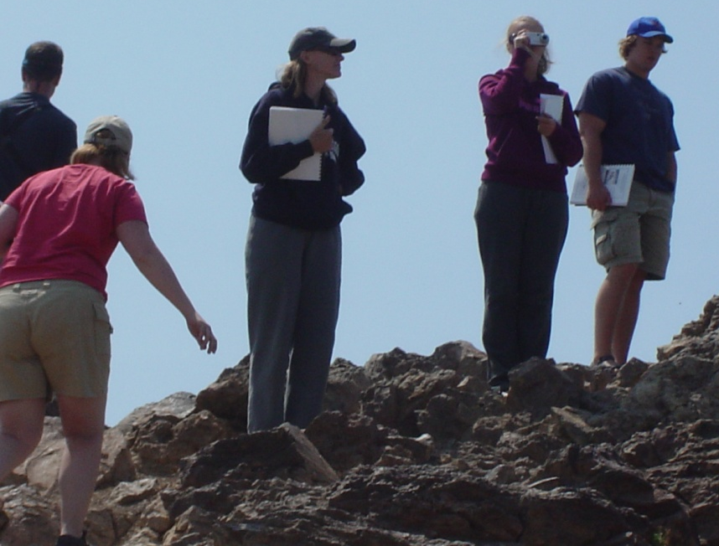
ACKNOWLEDGMENTS
Funding Sources:
Western Oregon University Faculty Development Fund
Cascades Volcano Association
WOU Research Assistants and ES407 Senior Seminar Students:
Jeff Budnick, Chandra Drury, Jamie Fisher, Tony Faletti
Denise Giles, Diane Hale, Diane Horvath, Katie Noll, Rachel
Pirot, Summer Runyan, Ryan Adams, Sandy Biester, Jody Becker, Kelsii Dana, Bill Vreeland, Dan Dzieken,
Rick Fletcher

Slide 46
Extent of Hypothesized Newberry Ice Cap (Donnelly-Nolan and Jensen, 2009)

Slide 47
Cinder Cone Distribution Relative to Hypothesized Extent of Newberry Ice Cap
Ice cap limit
Single cones within ice limit
Composite cones within ice limit
Single cones outside ice limit
Composite cones inside ice limit
Caldera lakes

Slide 48
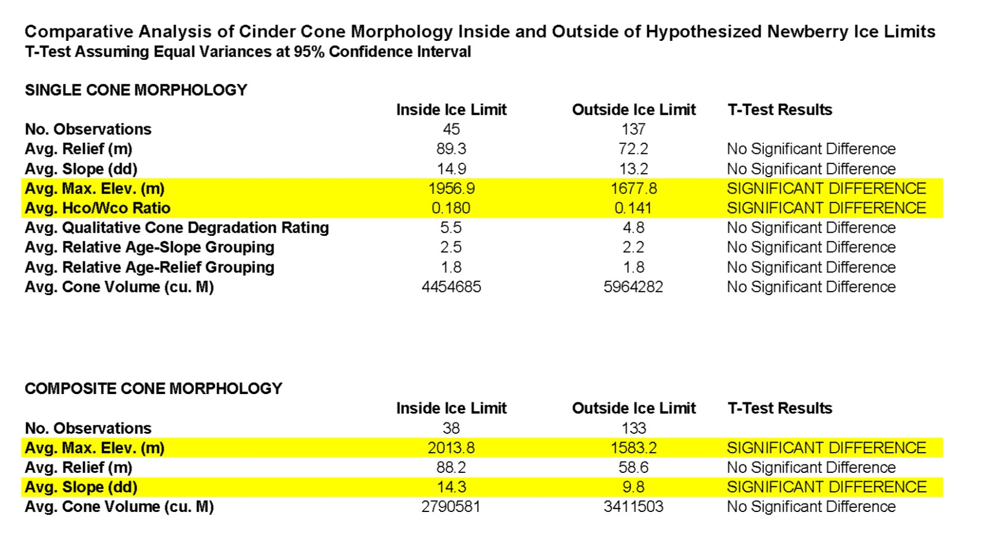
Cone Morphology Comparison Relative to Hypothesized Extent of Newberry Ice Cap
Avg. Cone Long Axis/Short Axis Ratio
1.30
1.35
No Significant Difference

