Slide 1
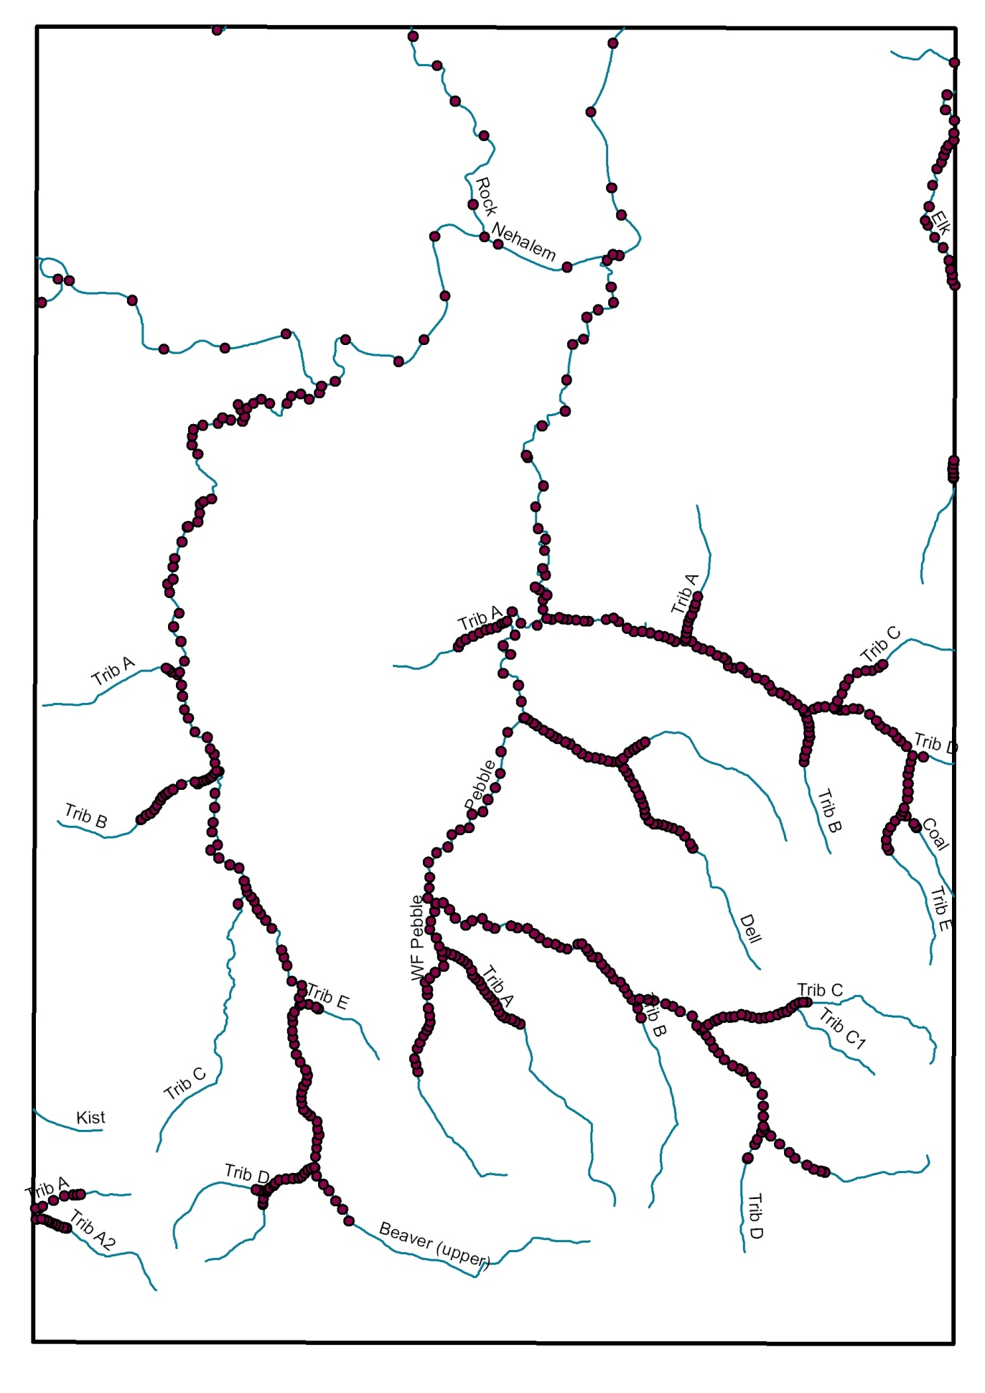
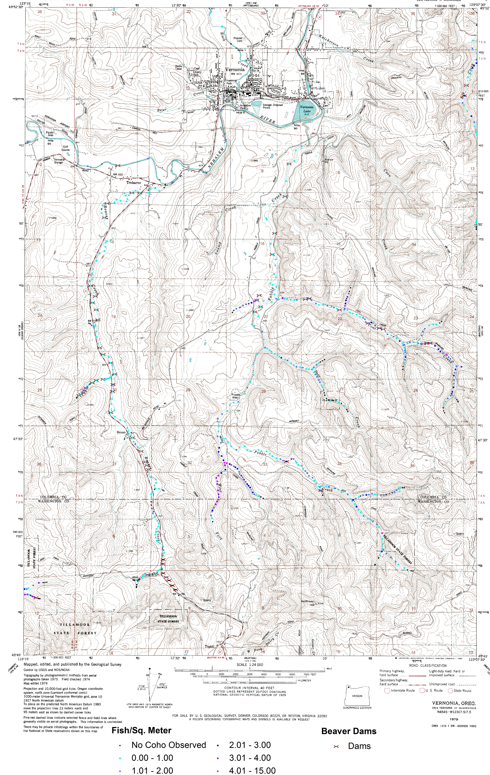
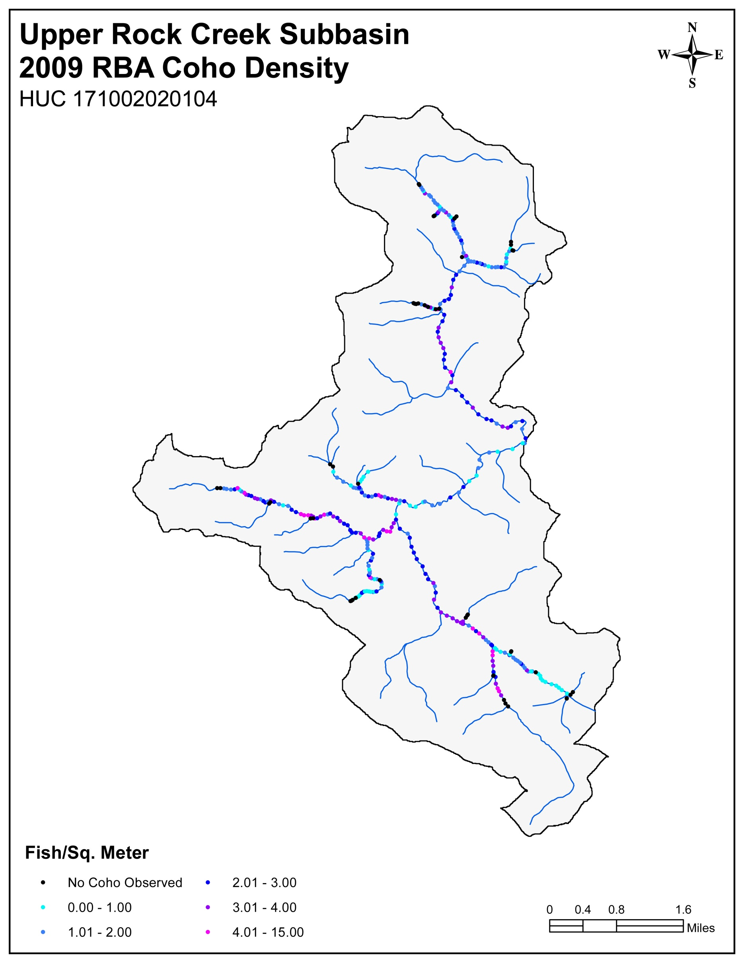
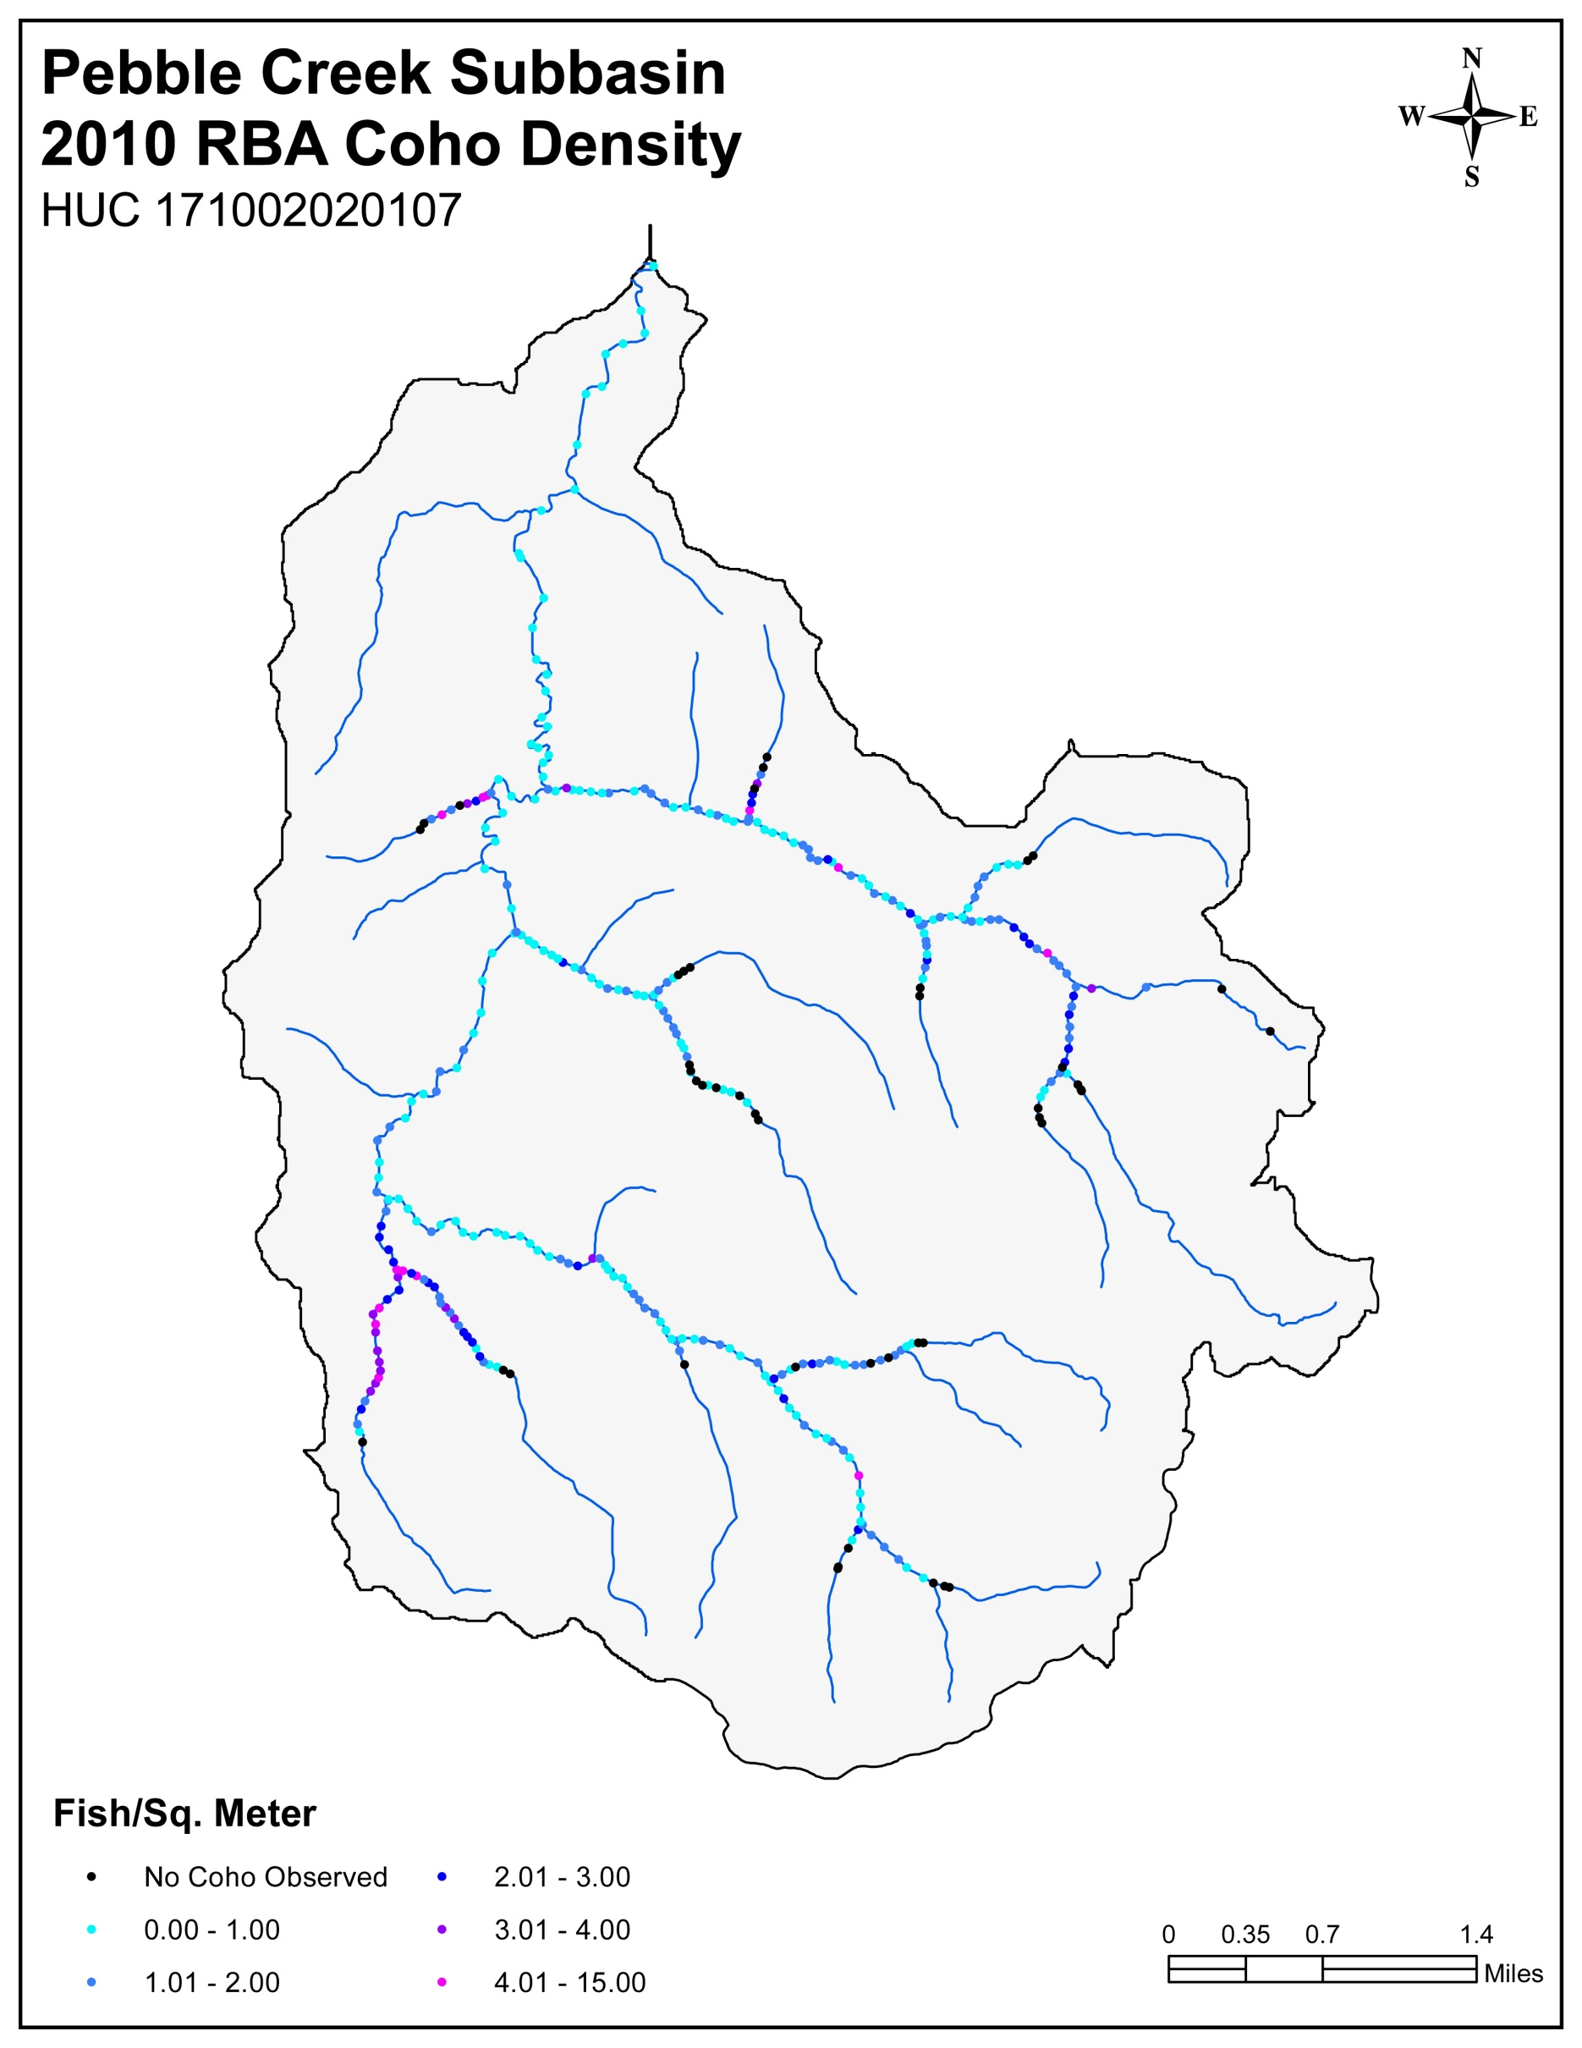



RAPID BIO-ASSESSMENT DATA CONVERSION PROCESS: Field Observation – Database Tables – GIS Map Layers
1. Bio-Surveys: Field Observations and Location Maps
2. Bio-Surveys: RBA Database Compilation
3. WOU Stream Routing
4. WOU Pool Registration
5. WOU: Map Production and Spatial Visualization
6. WOU: Data Layers and Project Deliverables
Stakeholders and Community Partners
Western Oregon University
Earth Science Team
Undergraduate Research Associates
Jody Becker
Cristina Francisco
Riccilee Keller
Aquilegia Leet
Brandon Snook
Ryan Stanley
William Vreeland

